Slide 1
Debugging: ITD/ILD calculation
2018/11/13

Slide 2
Problem/Overview
Signals from 0 degrees azimuth are showing up in neural activities of 45 and 90 deg neurons
Observation 1: If input gain is low, then ILD for different spatial locations all round to 0 (slide 4,5). If multiple spatially sensitive neurons share the same ILD, then they are no longer spatially sensitive.
Observation 2: The Fischer ILD calculation may not be viable for low frequencies (slides 7-10)
Possible remedies: Weigh ILD and ITD differently, depending on the frequency channel (duplex theory)

Slide 3
ILD Calculation: General Procedure
Convolve broad band noise with x degree az KEMAR HRTF
Filter using ERB Filter Bank
Calculate Energy Envelope Difference with Fischer’s code.

Slide 4
At low gain…
Red Box: All spatial directions share the same ILD (0) at low frequencies – meaning all spatial cells at low frequencies will fire.
i.e. cells of low CFs will have very broad spatial tuning.

Slide 5
At higher gain…
Better frequency separation at low frequencies.
The lines for 45 and 90 deg cross at medium to high frequencies – this will promote leakage into other spatial channels…?
At 0 degrees, there shouldn’t be leakage into other spatial channels.

Slide 6
At this point, the problem persists for frequency channels below 300 Hz
Left: ILD for the signal
Right: Cross-correlation activity for a -45 deg neuron, responding to a 0 deg signal: (what is the scale, in relation? – what is the cross correlation for 0 deg neuron?)
High Freq
Low Freq

Slide 7
At this point, the problem persists for frequency channels below 300 Hz
Envelope = contralateral energy envelope
Z = calculated ILD
P = neuron parameters
Sz(n,:) = Envelope.*(sigILD(z(n,:),p(n,:)));
Figure: ILD activity for the -45 deg neurons
I think this is the problem

Slide 8
At this point, the problem persists for frequency channels below 300 Hz
Combined ITD and ILD = neuron activity
Figure: Input to 45 deg neuron. Freq channels below 300 Hz have high inputs.
Procedure: Add the right figure in slide 6 to the figure in slide 7, then LPF.
Is the combination of ITD and ILD frequency dependent? No.
High low freq activity, probably due to the ILD calculation

Slide 9
sigILD()
P1: Max val
P2: Horizontal offset – based on neuron’s ILD
P3: Steepness of Sigmoid – sharpness of ILD tuning
P4: Vertical Offset
P2-P6 = fwhm of ILD tuning curve
Mean(P2-P6) = center of ILD tuning = calculated ILD
For each frequency channel (i.e. each neuron)
Function S = sigILD(z,P)
Lt=length(z); %length of signal i.e. time length
N=size(P,1);
%Form sigmoids
%Eq Gi on mid-left panel, page 3?
%Difference of sigmoids, not sum??
R1=((P(:,1)*ones(1,Lt))./(1+exp(-(ones(N,1)*z-(P(:,2)*ones(1,Lt)))./...
(P(:,3)*ones(1,Lt)))))+(P(:,4)*ones(1,Lt));
R2=((P(:,5)*ones(1,Lt))./(1+exp(-(ones(N,1)*z-(P(:,6)*ones(1,Lt)))./...
(P(:,7)*ones(1,Lt)))))+(P(:,8)*ones(1,Lt));
%Add to get input current
S=R1+R2;

Slide 10
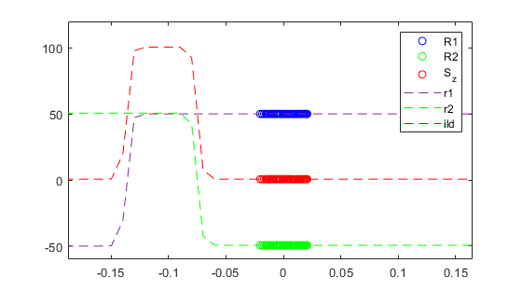
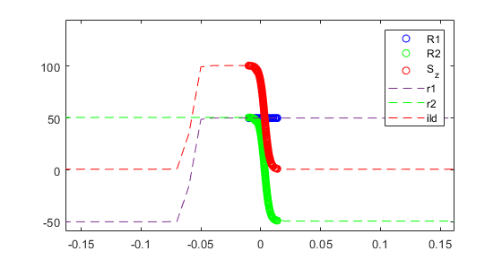
sigILD()
Two sigmoids: r1 and r2, blue and green dashed lines. Top: Higher frequency (~1000 hz). Bottom: Lower frequency (~280 Hz)
Their sum (or difference) is a single semi-rectangular shape
This shape is shifted to the left or right based on the neuron’s preferred ILD
R1 and R2 show where the envelope energy difference lie. The output value (S_z) is the red circles (looks like thick red line)
As ILDs decrease with frequency, they move closer to 0 (as shown in the plots). This enables the -45 deg neuron to fire to a 0 deg signal.

Slide 11
Binaural processing
For sound sources that are distant from the listener, ILDs are negligible below about 500 Hz, but may be as large as 20 dB at high frequencies (Feddersen et al, 1957).
For sound sources close to the head, considerable ILDs can occur even at low frequencies.
The Duplex Theory states that the sound localization is based on ILDs at high frequency and ITDs at low frequencies.

Slide 12
ITD calculation
Cross correlation function
L and R channels and relayed based on the neuron’s “best ITD”
Junzi’s code uses a single ITDs for each direction
BUT is ITD frequency dependent?

Slide 13
Current ITD calculation (frequency independent)
ITDlist = [800, 400, 0, -400, -800]/1000;
Corresponding to [-90,45,0,45,90] deg az
Note that the signs are opposite – the model works with this sign switch

